Slide 1
Annotated Lecture Slides for Sugar and Salt Solutions
LECTURE DEMO TITLE
Electrolyte and Non-electrolyte Solutions
AUTHORS
Robert Parson (University of Colorado Boulder)
Trish Loeblein (University of Colorado Boulder)
COURSE
Introductory / Preparatory College Chemistry
COPYRIGHT: This work is licensed under a Creative Commons Attribution 4.0 International License.

Slide 2
Learning goals
Explain the difference between electrolytes and nonelectrolytes in terms of conductivity, the nature of the compound, and dissociation.
Describe and visualize what happens at the atomic or molecular scale when an electrolyte or a nonelectrolyte dissolves in water

Slide 3
Ionic Compounds
Form from the electrostatic interaction between cations and anions.
Electrostatic forces: attraction/repulsion between charged particles.
Ionic compounds form between metals and nonmetals.
-
-
+
+
-
+
Notes:
Review slide from previous class, where ionic and covalent compounds were discussed, including their metal/non-metal composition

Slide 4
Which compound is ionic?
CO
MgF₂
Al₂O₃
Both CO and MgF₂
Both MgF₂ and Al₂O₃
Notes:
Used here as review of material covered in a previous class

Slide 5
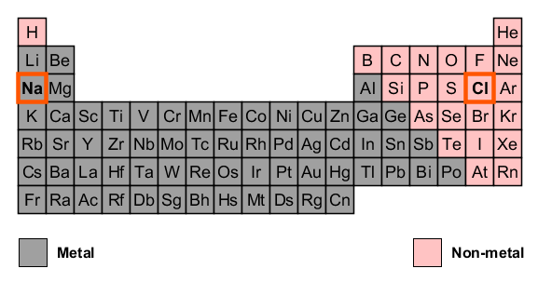
Which compound is ionic?
CO
MgF₂
Al₂O₃
Both CO and MgF₂
Both MgF₂ and Al₂O₃
A metal combined with a non-metal make an “ionic compound”.
Notes:
Follow-up discussion slide for previous clicker Q, using the periodic table representation shown in the simulation.

Slide 6
Benchtop DEMONSTRATION
(Next 3 slides)
Notes:
(optional accompanying demonstration pairing a benchtop chemical demo with the demonstration using the Macro tab of the sim)
First the differing conductivities of sugar and salt solutions were shown using the using the sim (Macro Tab) and then the real conductivity apparatus was used to measure the conductivity of two “unknown” solutions.

Slide 7
Beaker Contents | Conductivity Observations
Unknown 1
Unknown 2
Water
Notes:
(optional) Blank slide for in-class annotation during benchtop demonstration
Unknown 1 is a sugar solution, while Unknown 2 is a salt solution.
See facilitation guide for detailed notes

Slide 8
Beaker Contents | Conductivity Observations
Unknown 1 | No conductivity
Unknown 2 | High conductivity
Water | Distilled (pure) water: No conductivity Tap water: Some conductivity
Notes:
Summary of benchtop demonstration results
Other key follow-up questions (which could take place before or after the concept question on the next slide):
What would happen if I didn’t rinse the probe off between solutions? Is this different depending on what order I test the solutions?
What’s the difference between tap water and distilled (pure) water? Why does one conduct electricity?

Slide 9
Which solution is which?
1 is sugar and 2 is salt
2 is sugar and 1 is salt
Both are sugar
Both are salt
Notes:
Correct answer: A
Representative results from pre-general chemistry: 78% correct
Note that this concept question could be asked after testing the unknown solutions, but before discussing water, tap water, etc.

Slide 10
Electrolytes and Nonelectrolytes
Electrolytes
conduct electricity
substances that release ions when dissolved in water
This process is also called dissociation or ionization
Nonelectrolytes
substances that do NOT dissociate in water
do NOT conduct electricity
Ionic compounds (if they dissolve in water) are always electrolytes.
Most molecular compounds are nonelectrolytes.
Notes:
Slide could be shown in class, or discussed and left for posted notes only.

Slide 11
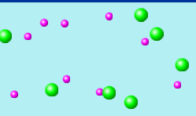
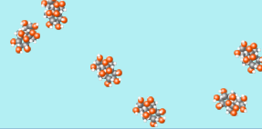
If the atom-scale view of a compound in water looks like the picture on the right (II.), you might categorize the compound as…
I.
II.
a. Ionic b. Molecular c. Neither
Notes:
Correct answer: B
Representative results from pre-general chemistry: 81% correct (when used after sim demo with micro tab); 66% correct (when using prior to micro tab)
Follow-up discussion: Students were asked to explain what features they used in the pictures to decide on their answer

Slide 12
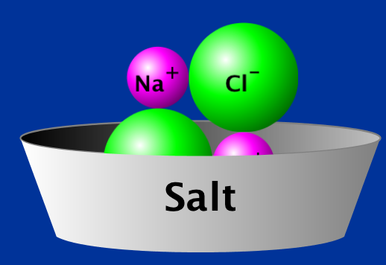
Ionic Compound Example
NaCl(s) → Na⁺(aq) + Cl⁻ (aq)
Key features of ionic solid:
Repeated units in larger lattice
Units are made of charged ions
Notes:
Key facilitation notes:
Remember to annotate that (aq) stands for aqueous, i.e. dissolved in water, if students have not already been introduced to this notation
Structural features to highlight: repeat units (not individual molecules) AND the ratio for net neutral charge
Emphasize that solid NaCl already consists of ions, even though we don’t write the charges as part of the chemical formula (the ionic nature doesn’t go away just because of how we write it).

